Slide 1
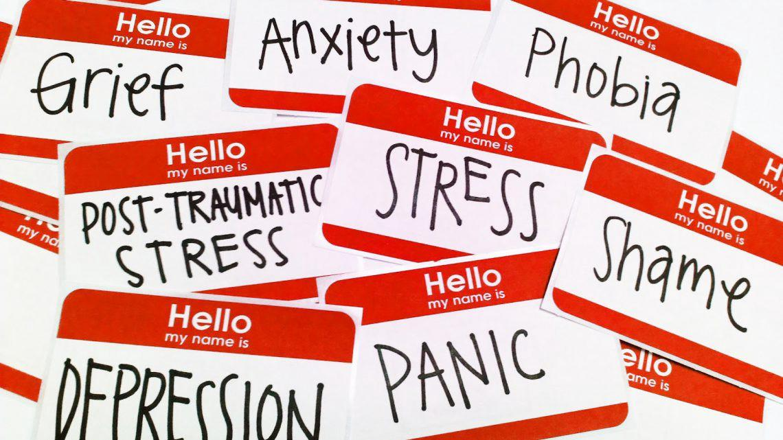

Mental Health: A Worldwide View MSBD5005: Data Visualization Project Presentation
BANERJEE, Rohini (20543577) | RAMALINGAM, Poojaa (20214528)
MEHROTRA, Priya (20580317) | PALANIYAPPAN VELUMANI, Reshika (20544313)

Slide 2
Problem Statement and Inspiration
Inspiration:
Brain disorders have a stigma that other illnesses do not have. Yet, there is no health without mental health.
Mental health and substance use disorders are still significantly under-reported. This is true across all countries, but particularly in lower incomes where data is scarce.
Problem Statement:
GDP v/s Mental Health: Does Money Buy Happiness?
Mental Health and Employment
Mental Health Comorbidity: Suicide and Drug Abuse
#BreakTheStigma: A Social Media Delusion?

Slide 3
Does Money Buy Happiness?
GDP & Mental Health

Slide 4
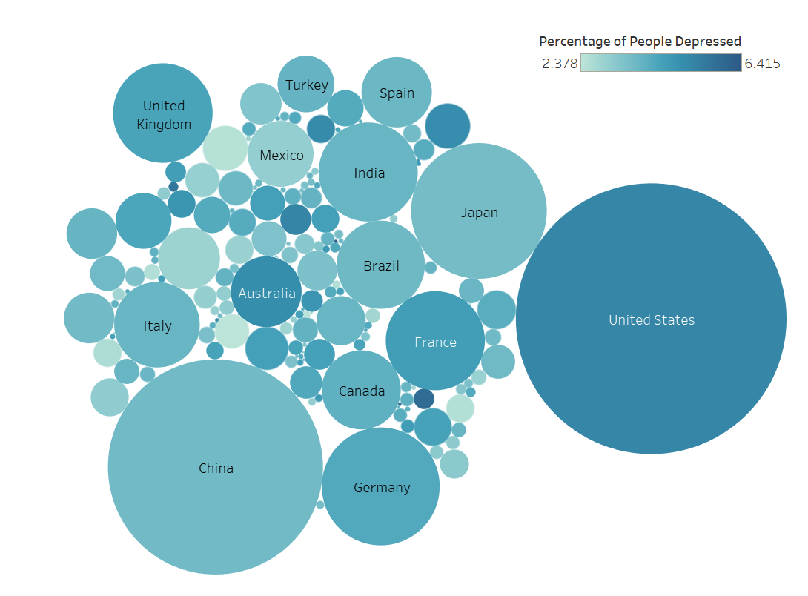


Slide 5
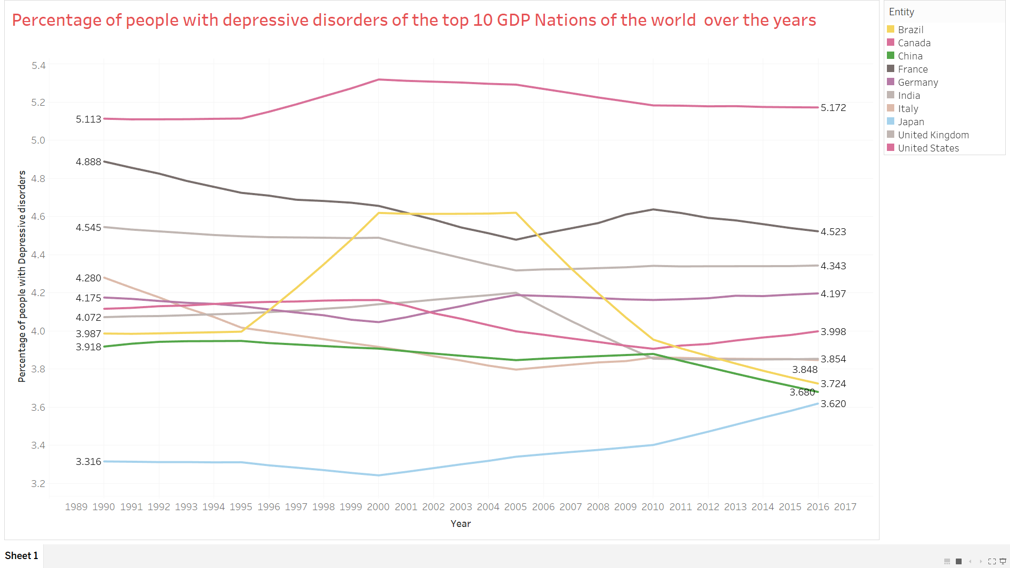
The Top 10 GDP Nations vs People with Depressive Disorders over a period of 30 years

Slide 6
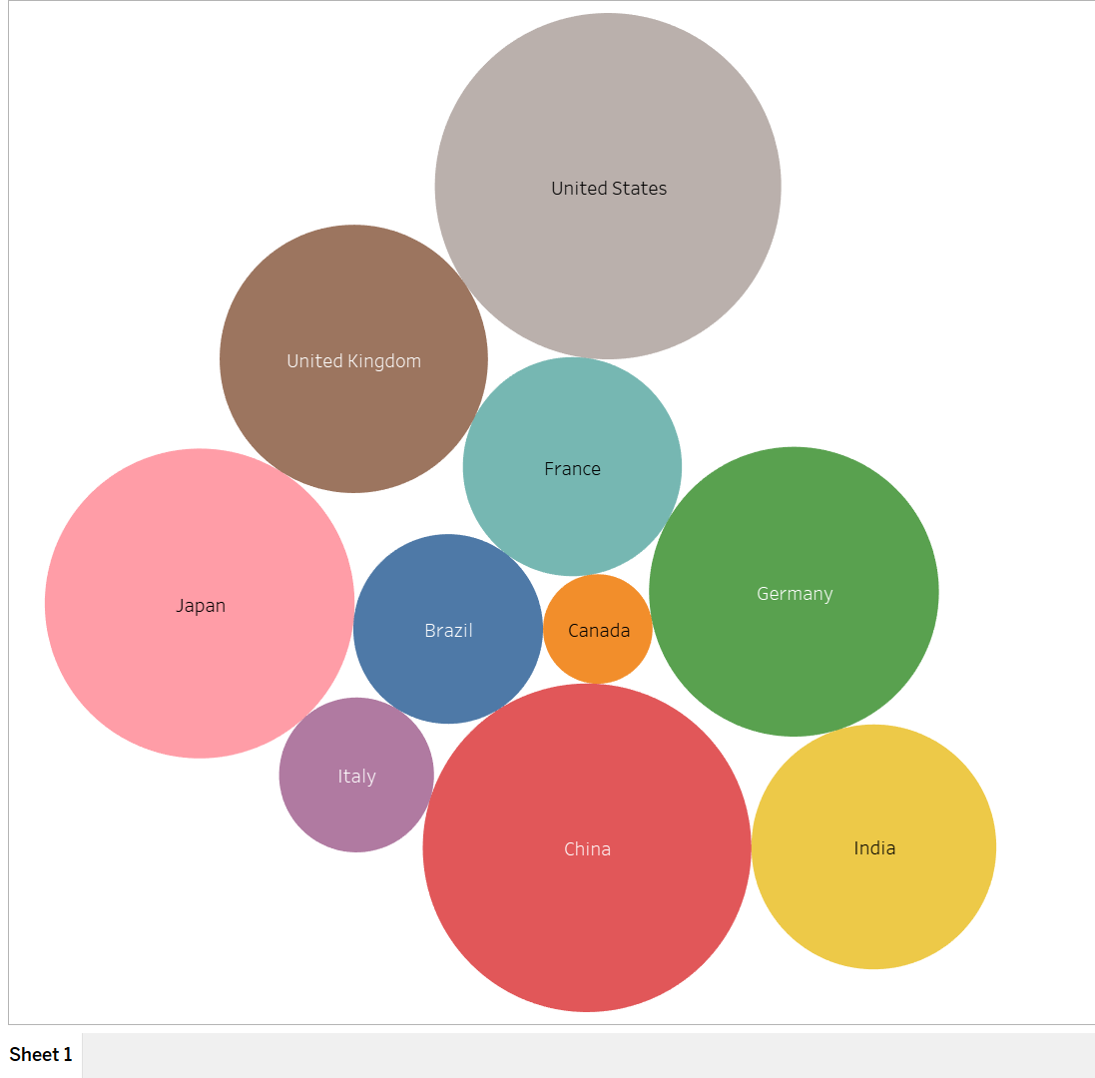
Packed Bubble Visualization showing Top 10 GDP Nations

Slide 7
Mental Health and Employment

Slide 8
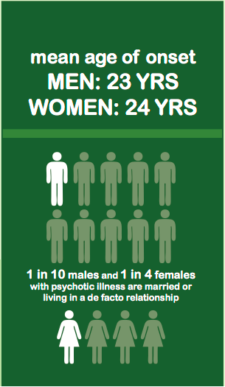
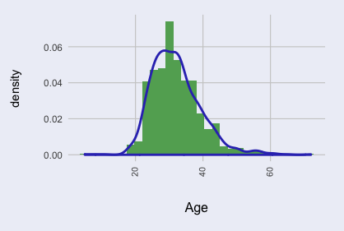
Conventional Age Distribution w.r.t Population

Slide 9
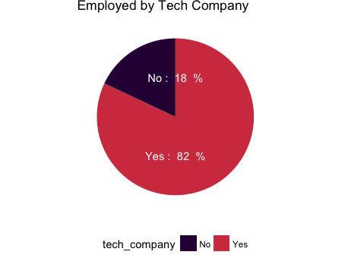
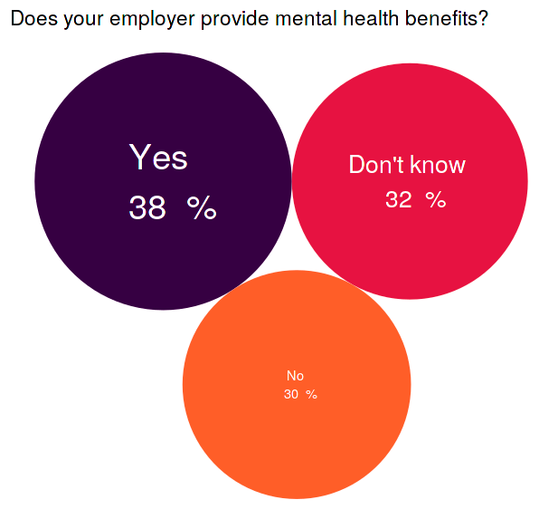
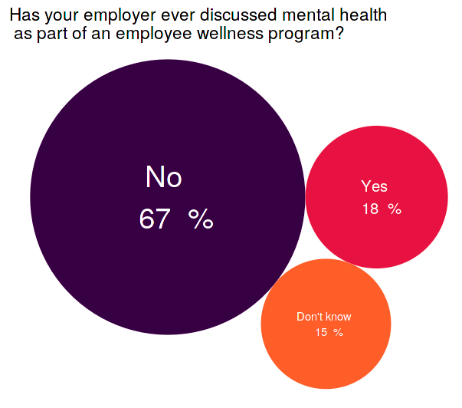
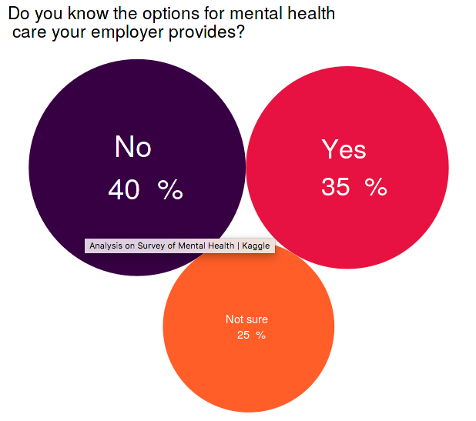

Slide 10
Mental Health Comorbidity: Suicide and Drug Abuse

Slide 11
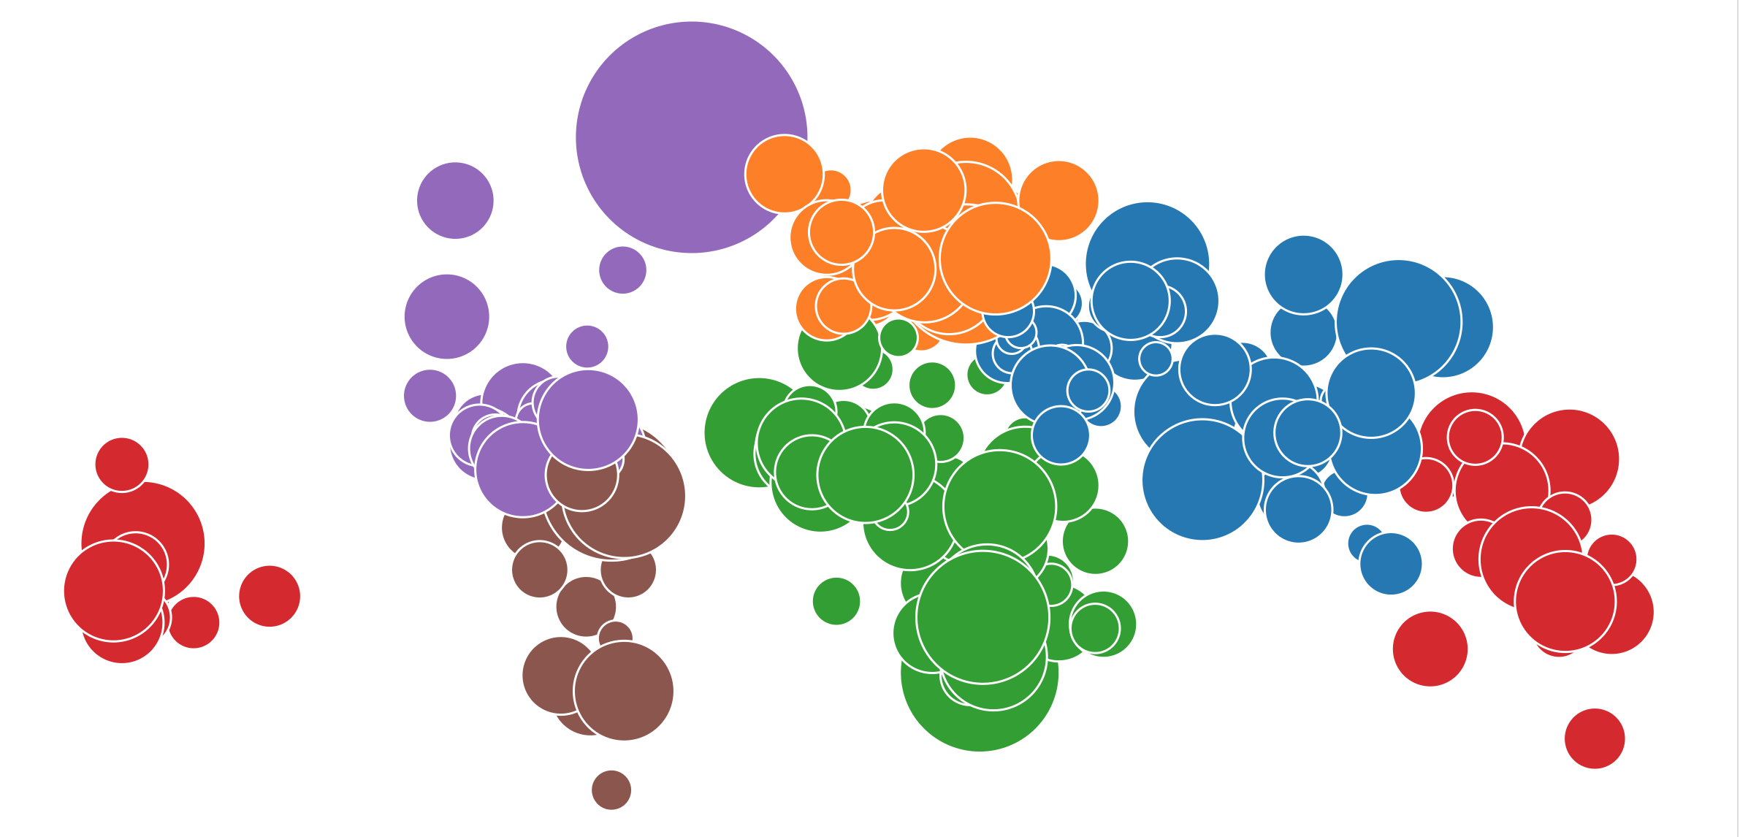
Worldwide Suicide Rate

Slide 12
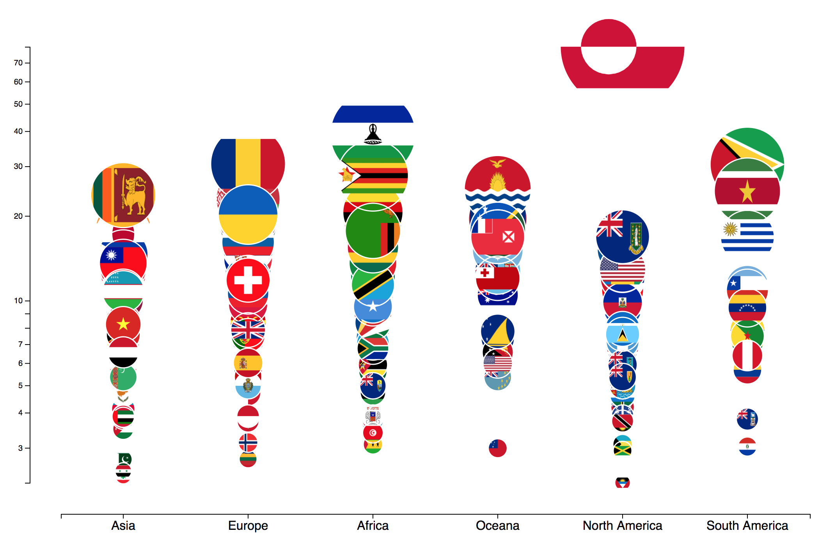
Suicide: A Continent Based View

Slide 13
#BreakTheStigma: A Social Media Delusion?

Slide 14
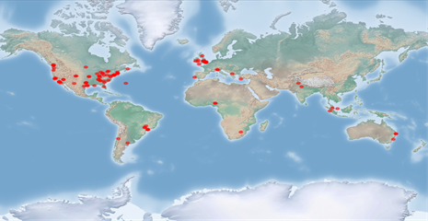
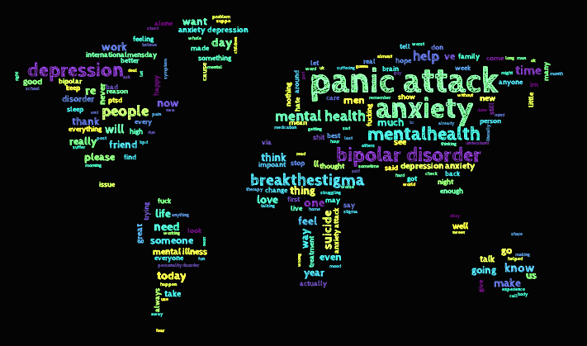
Mental Health Tweet: Sentiment Analysis
Geographic location of tweets related to mental health
Word cloud (words not based on geographic region):

Slide 15
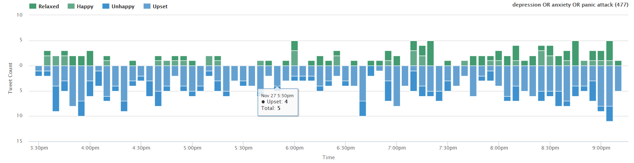
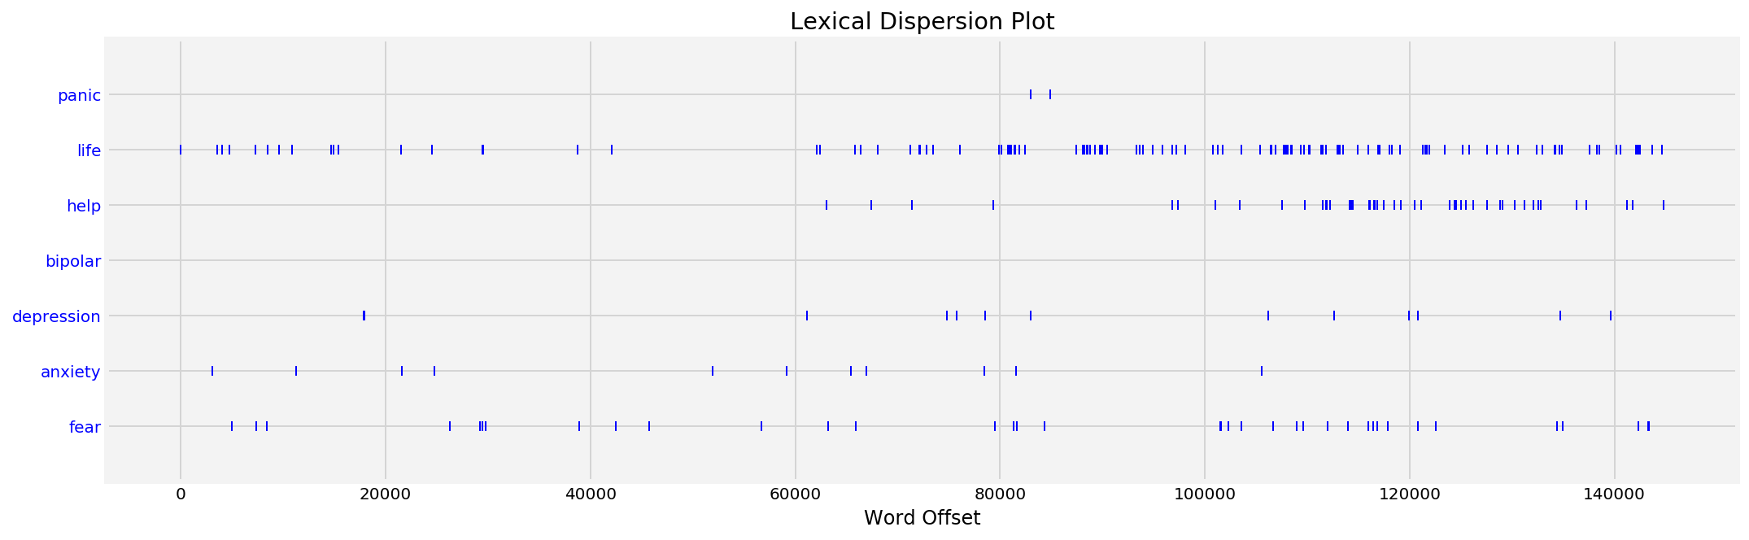
Emotion Stacked Bar Graph:
What time of the day do people become sad?
Lexical Dispersion Plot:
What do self-help related books concentrate on?

Slide 16
Mental Health: An Overall View

Slide 17
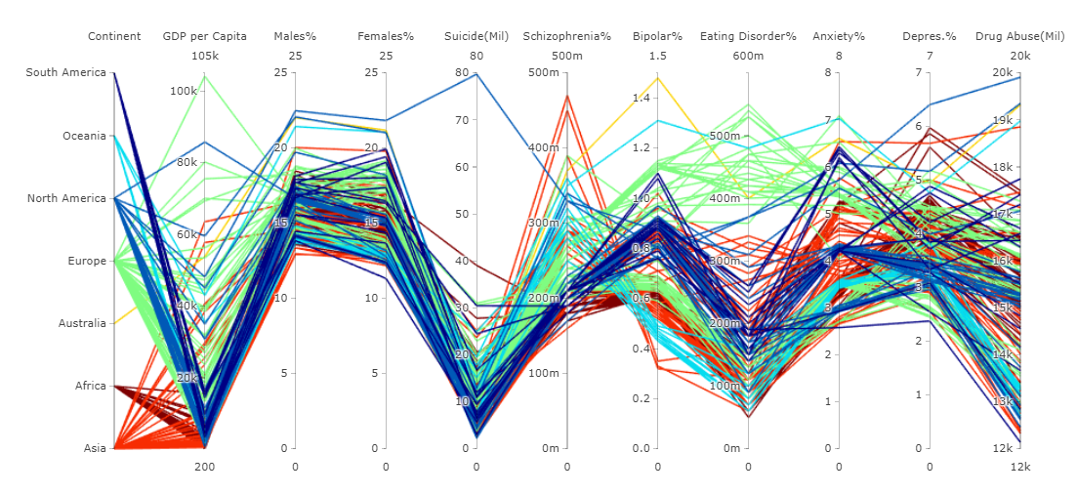
Parallel Coordinates: An Overall Analysis

Slide 18
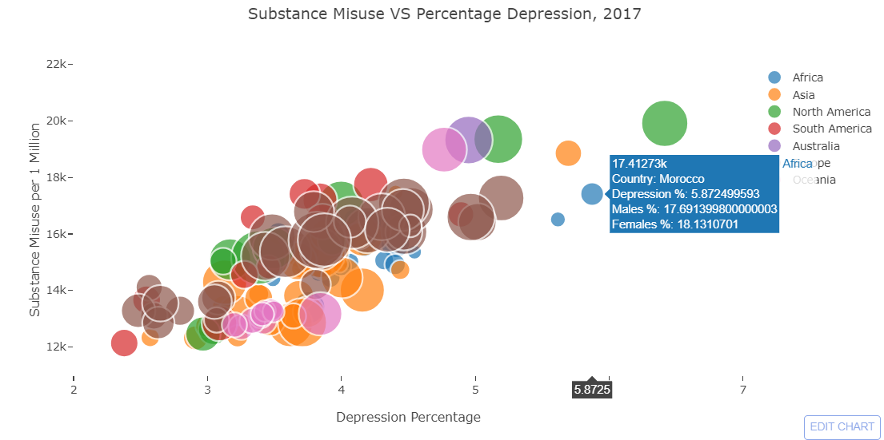
GDP, Drugs and Depression: A Closer Look

Slide 19
Summary of Inferences
Higher the GDP of a country, more number of people suffer from mental health related issues.
High number of people in technology based companies tend to suffer from mental illness.
There is still not enough awareness and support for mental health in workplaces.
There is a high correlation between Substance Abuse and Depression.
Greenland has the highest number of Suicide rates in a year.
Higher number of tweets with a negative sentiment occurs during early morning or late night.
Australia has the highest number of people suffering from Bipolar Disorder.
Most of the European countries have high Eating Disorders.

Slide 20
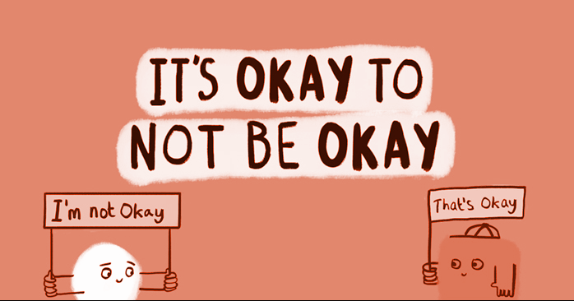
Thank You!

